Slide 1
Homeless and Healthcare
Aaron Wright

Slide 2
Characteristics
50% report alcohol use
50% report Mental illness
Males - 70.8%
Ages 31-50 – 43.2%
White, Non-Hispanic – 47.8%
(National Alliance to End Homelessness, 2015)
Notes:
Homeless described as individual or family without permanent housing who may live on the streets, shelters, missions, abandoned buildings, or vehicles. Could also include a friends house.
Alcohol use is a big problem
Behavioral health problems go hand in hand with substance abuse issues
Difficult to get statistics on, transient, don’t follow up.

Slide 3
Prevalence
January 2015 - 564,708
358,422 individuals
206,286 homeless family members
83,170 chronically homeless individuals
13,105 chronically homeless family members
(National Alliance to End Homelessness, 2015)
Notes:
family members= individual member of family
Chronically homeless is someone who has been homeless for a minimum of 12mos

Slide 4
Homeless Culture
Wide range of backgrounds
Friendship
Inversion of values
Violence
Different ages
    1.7 million youth
(Philipps, 2012; O’Sullivan Oliveira & Burke, 2009)
Notes:
Anyone can be homeless, black, white, Asian, Hispanic. Young, old, male, female, pregnant, gay, straight, transgendered. So you get all those different cultural elements.
Many homeless struggle to make friends when not homeless. Difficult to leave homeless friends behind
Long term homeless receive more respect. More trauma equals more respect. Don’t want healthcare because you get more respect without it.
Violence solves everything. Violence is power
Young homeless generally fear adults, so they don’t interact with those trying to help. Wiccan is the most prevalent religion among street youth.

Slide 5
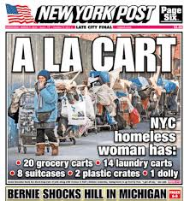
Media Portrayal
Notes:
New york post front page news. Homeless shaming. Could this be mental illness shaming?

Slide 6
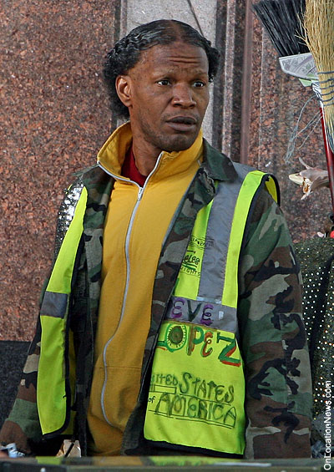
Media Portrayal

Slide 7
Media Portrayal
Men
Individuals
Minorities
Unemployed
Violent
Drug use
(Erikson, 2012; National Alliance to End Homelessness, 2015)
Notes:
Unfavorable media portrayal. Also not an accurate portrayal.

Slide 8
Politics
Homeless Veterans
    47,725 homeless veterans in 2015
    $1.641 billion in 2015
Non-Veteran
    $2.480 billion in 2015
Homeless veterans have historically received a favorable political outlook
(National Alliance to End Homelessness, 2015)
Notes:
New York currently trying to outlaw homelessness. Laramie busses homeless out of town. Our society has some hero worship of veterans, they are held in high esteem.

Slide 9
Current Science
Lots of studies
Study limitations
Unhealthy population
Notes:
Difficult to conduct studies as population is transient and difficult to follow up with. Cant always extrapolate data from one homeless study to homeless in other areas, for instance cold weather homeless problems are difficult from warm weather homeless problems.

Slide 10
Homeless Healthcare Needs
Same as Non-Homeless, but with added difficulties
Trust!!
Housing AND support
Healthy food, clean water
Transportation
(Nelson, et a., 2015)
Notes:
Homeless suffer from diabetes, HTN, hyperlipidemia, and mental illness
Homeless have been ridiculed by mainstream society, they are ignored on a daily basis while they are experiencing some of their most difficult moments. They do not feel anyone cares about them.
Housing is usually the #1 priority. Lots of money is spent on this with varying degrees of success. Support is needed to help patient transition to mainstream.

Slide 11
Common Medical Problems
Mental illness
Traumatic brain injury
Diabetes
Injuries and violence
STIs
Skin and foot problems
Exposure related conditions
(Maness & Khan, 2014)
Notes:
Rates of mental illness vary with each study, but it’s a significant problem
TBI 5 times the rate of general population. Ties in with mental illness and substance abuse
Poor diet does no favors for the diabetic. Unable to afford supplies to check blood glucose levels
Physical violence and rape are common in the homeless community. Trauma is a common problem. Rape and threat of violence tie more into mental illness
STIs more prevalent in homeless women due to rape and prostitution.
Lice, scabies, and secondary bacterial infections are endemic in homeless. Due to wet clothing (trench foot) and exposure to elements. Note everyone has shoes
Frostbite, heat stroke

Slide 12
What’s Not Being Met?
Housing
Transition support
Mental Health
Basic healthcare needs
TRUST!
Transportation
(Maness & Khan, 2014)
Notes:
Ideally, housing should be the first priority. Social work can be extremely helpful with this.
Not being met due to difficulties of working with this population. They are nomadic, they can’t make it to appointments due to transportation issues, they can’t afford medications, they have substance abuse problems. By getting housing and healthcare, they leave behind their support system.
These people have been treated poorly and ignored by a lot of people, trust is imperative.

Slide 13
Role of NP
Treat the whole person
Offer judgment free healthcare
Motivational interviewing
Notes:
Difficult to treat whole person as NP might want to zero in on disease process. Have to develop trust with person first
Don’t judge prostitutes or those with STIs. Don’t judge smokers or drug users.
Use MI to ascertain how ready they are go leave the streets or stop using drugs.

Slide 14
What Needs To Be Done?
Multidisciplinary approach
Patient centered care
Bring healthcare to homeless
Help them transition
Do what you can
Notes:
One person cannot adequately treat the homeless population alone. Team should include social worker, behavioral health specialist, pharmacists, knowledgeable housing specialists
Patient centeredness helps develop trust
If possible take healthcare to the homeless. Removes the transportation barrier.
By obtaining housing, these people lose their support network and friends. More programs to help transition could be helpful
Can’t fix everyone, or everything. Latch onto any wins.

Slide 15
References
Erikson, E. (2006). The Representation of Homelessness in the Nightly News. Journal of Communication, Culture, and Technology. 1-18
Maness, D. L. & Khan, M. (2014). Care of the homeless: an overview. American Family Physician, 89(8). 634-640.
National Alliance to End Homelessness. (2015). Snapshot of homelessness. Washington, D.C.
Nelson, G., Patterson, M., Kirst, M., Macnaughton, E., Isaak, C. A., Nolin, D. . . . Goering, P. N. (2015). Life changes among homeless persons with mental illness: a longitudinal study of housing first and usual treatment. Psychiatric Services,66(6). 592-597.
O’Sullivan Oliveira, J. & Burke, P. J. (2009). Lost in the shuffle: culture of homeless adolescents. Pediatric Nursing, 35(3). 154-161.
Philipps, K. (2012). Homelessness: causes, culture and community development as a solution. Pell Scholars and Senior Theses. 1-55

